Slide 1
SERIES AND PARALLEL AC CIRCUITS

Slide 2
Part (1)

Slide 3
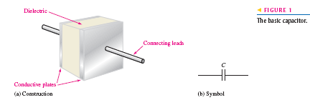
THE BASIC CAPACITOR
A capacitor is a passive electrical component that stores electrical charge and has the property of capacitance.
It is constructed of two parallel conductive plates separated by an insulating material called the
dielectric.
Connecting leads are
attached to the parallel
plates.

Slide 4
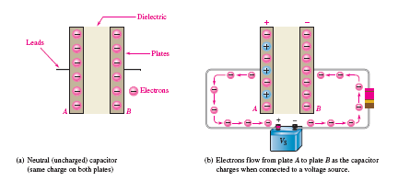
How a Capacitor Stores Charge
In the neutral state, both plates of a capacitor have an equal number of free electrons, as indicated in Figure 2(a).
When the capacitor is connected to a voltage source through a resistor, as shown in part (b), electrons are removed from plate A, and an equal number are deposited on plate B.

Slide 5
How a Capacitor Stores Charge
As plate A loses electrons and plate B gains electrons, plate A becomes positive with respect to plate B.
During this charging process, electrons flow only through the connecting leads. No electrons flow through the dielectric of the capacitor because it is an insulator.

Slide 6
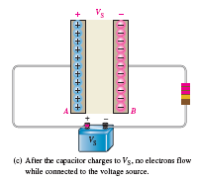
How a Capacitor Stores Charge
The movement of electrons stopped when the voltage across the capacitor equals the source voltage, as indicated in Figure 2(c).

Slide 7
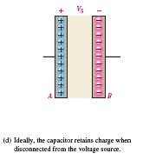
How a Capacitor Stores Charge
If the capacitor is disconnected from the source, it retains the stored charge for a long period of time and still has the voltage across it, as shown in Figure 2(d).
A charged capacitor can act as a temporary battery.

Slide 8
Capacitance
The amount of charge that a capacitor can store per unit of voltage across its plates is its capacitance, C.
That is, capacitance is a measure of a capacitor’s ability to store charge.
where C is capacitance, Q is charge, and V is voltage.
The Unit of Capacitance is the farad (F)

Slide 9
Capacitance
Example : A certain capacitor stores 50 micro coulombs with 10 V across its plates. What is its capacitance in units of microfarads?
Solution: C = Q / V
= 50 µC/ 10 V = 5 μF

Slide 10
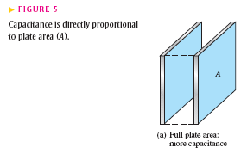
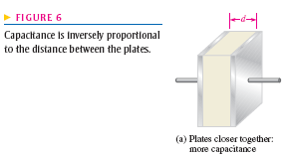
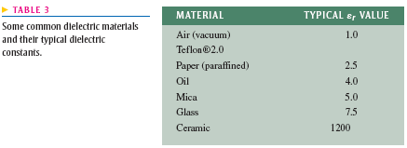
Physical Characteristics of a Capacitor
See Reference

Slide 11
SERIES CAPACITORS
The current must be the same at all points.
Since current is the rate of flow of charge, the amount of charge stored by each capacitor is equal to the total charge, expressed as
QT = Q1 = Q2 = Q3= …………=Qn

Slide 12
SERIES CAPACITORS
According to Kirchhoff’s voltage law, the sum of the voltages across the charged capacitors must equal the total voltage, as shown in Figure 18(b).
This is expressed in equation form as
VT = V1 + V2 + V3 + …….. Vn

Slide 13
SERIES CAPACITORS
When this relationship is substituted into each term of the voltage equation, the following result is obtained:

Slide 14
SERIES CAPACITORS
Since the charges on all the capacitors are equal, the Q terms can be factored and canceled, resulting in

Slide 15
SERIES CAPACITORS
Capacitor Voltages: Since the charge on any capacitor in series is the same as the total charge.
The voltage across any individual capacitor in series
with the following formula:

Slide 16
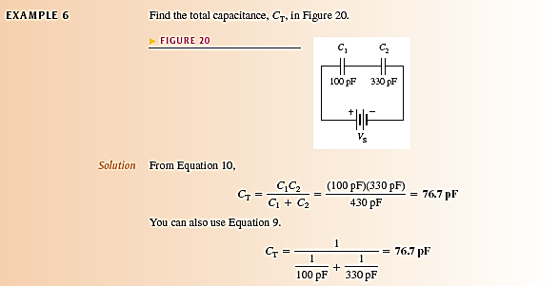
SERIES CAPACITORS

Slide 17
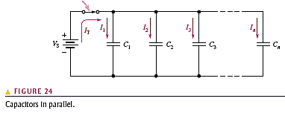
PARALLEL CAPACITORS
The total parallel capacitance is the sum of all the capacitors in parallel.

Slide 18
PARALLEL CAPACITORS

Slide 19
CAPACITORS IN AC CIRCUITS
A capacitor blocks DC. While a capacitor passes AC but with an amount of opposition, called capacitive reactanceمفاعلة سعوية , that depends on the frequency of the AC.
Since current is the rate of flow of charge (electrons).
Therefore, instantaneous current, i, can be expressed as

Slide 20
CAPACITORS IN AC CIRCUITS
The instantaneous capacitor current is equal to :

Slide 21
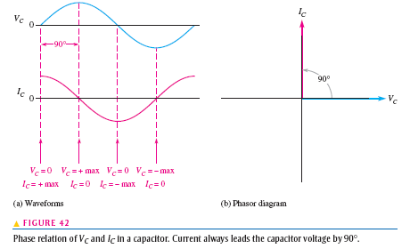
Phase Relationship of Current and Voltage in a Capacitor

Slide 22
Capacitive Reactance XC
It is the opposition to sinusoidal current, expressed in ohms. The symbol for capacitive reactance is Xc
Therefore, Xc inversely proportional to i and thus inversely proportional to(dv/dt) or f, shown as, 1/f.

Slide 23
Capacitive Reactance XC
From the same relationship i = C(dv/dt), if dv/dt is constant and C is varied an increase in C produces an increase in i, and a decrease in C produces a decrease in i.
Therefore, Xc inversely proportional to i and thus inversely proportional to capacitance.

Slide 24
Capacitive Reactance XC
The capacitive reactance Xc is inversely proportional to both f and C
XC is inversely proportional to fC, shown as 1 / fc
The derivation is given in Appendix B.

Slide 25
Capacitive Reactance XC
Example : A sinusoidal voltage is applied to a capacitor, as shown in Figure 44. The frequency of the sine wave is 1 kHz. Determine the capacitive reactance.

Slide 26
Capacitive Reactance XC
Solution:

Slide 27
Capacitive Reactance XC
Reactance for Series Capacitors:
Reactance for Parallel Capacitors:

Slide 28
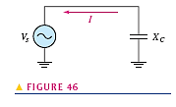
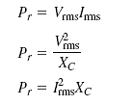
Ohm’s Law & Power in a Capacitor

Slide 29
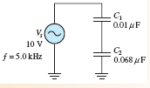
Capacitive Voltage Divider
Example: What is the voltage across C2 in the circuit of Figure 48?

Slide 30
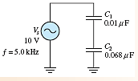
Capacitive Voltage Divider
Solution:

Slide 31
Part (2)

Slide 32
ANALYSIS OF SERIES RC CIRCUITS
Ohm’s law and Kirchhoff’s voltage law are used in the analysis of series RC circuits to determine voltage, currents and impedance
The application of Ohm’s law to series RC circuits involves the use of the phasor quantities of Z, V, and I.

Slide 33
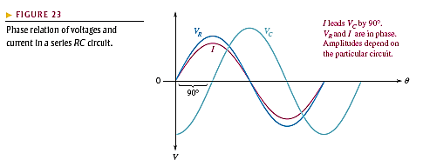
ANALYSIS OF SERIES RC CIRCUITS
Phase Relationships of Current and Voltages
The resistor voltage is in phase with the current, and the capacitor voltage lags the current by 90⁰ .

Slide 34
SERIES RC CIRCUITS
Phase Relationships of Current and Voltages
Therefore, there is a phase difference between the resistor voltage, VR, and the capacitor voltage, VC, as shown in the waveform diagram of Figure 23.

Slide 35
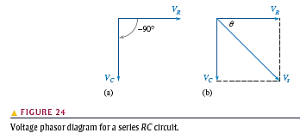
SERIES RC CIRCUITS
Phase Relationships of Current and Voltages
From Kirchhoff’s voltage law, the sum of the voltage drops must equal the applied voltage.

Slide 36
SERIES RC CIRCUITS
Phase Relationships of Current and Voltages
However, since VR and VC are not in phase with each other, they must be added as phasor quantities, with VC lagging VR by 90°, as shown in Figure 24(a).

Slide 37
SERIES RC CIRCUITS
As shown in Figure 24(b), Vs is the phasor sum of VR and VC,
Vs = VR – j VC

Slide 38
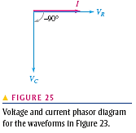
SERIES RC CIRCUITS

Slide 39
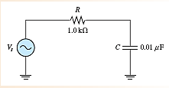
SERIES RC CIRCUITS
For the series RC circuit in Figure 29, determine the magnitude of the total impedance and the phase angle for each of the following values of input frequency:
(a) 10 kHz
(b) 20 kHz
(c) 30 kHz

Slide 40
SERIES RC CIRCUITS
(a) 10 kHz

Slide 41
SERIES RC CIRCUITS
(b) 20 kHz

Slide 42
SERIES RC CIRCUITS
(a) 30 kHz

Slide 43
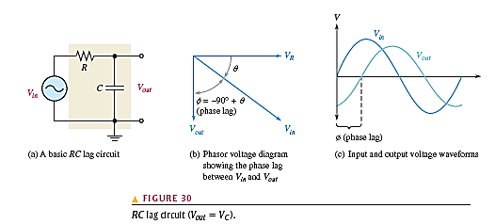
The RC- Lag Circuit
It is a phase shift circuit in which the output voltage lags the input voltage by a specified amount.

Slide 44
The RC Lag Circuit
As you know, ϴ is the phase angle between the current and the input voltage(I&Vin), is also the phase angle between the resistor voltage and the input voltage (VR&Vin) because VR and I are in phase with each other.

Slide 45
The RC Lag Circuit
Since VC lags VR by 90⁰ the phase angle between the capacitor voltage and the input voltage is the difference between -90⁰ and ϴ as shown in Figure 30(b).

Slide 46
The RC Lag Circuit
The capacitor voltage VC is the output, and it lags the input, thus creating
a basic lag circuit.

Slide 47
The RC Lag Circuit
The i/p and o/p voltage waveforms of the lag circuit are shown in Figure 30(c). The amount of phase difference, φ between i/p and o/p is dependent on the relative sizes of XC and R, as is the magnitude of the output voltage.

Slide 48
The RC Lag Circuit
Phase Difference Between Input and Output
The output voltage in polar form is
Vout = I XC ∠(-90° + ϴ)
The output voltage is at an angle of (-90° + ϴ) with respect to the input voltage.

Slide 49
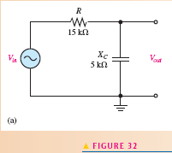
The RC Lag Circuit
Example: Determine the amount of phase lag from input to output in each lag circuit in Figure 32

Slide 50
The RC Lag Circuit

Slide 51
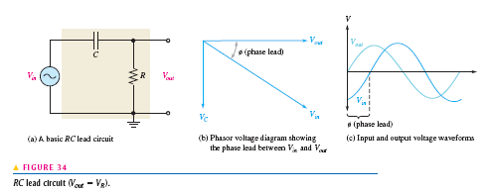
The RC- Lead Circuit
An RC- lead circuit is a phase shift circuit in which the output voltage leads the input voltage by a specified amount.

Slide 52
The RC- Lead Circuit
When the output of a series RC circuit is taken across the resistor rather than across the capacitor, as shown in Figure 34(a), it becomes a lead circuit.

Slide 53
The RC- Lead Circuit
Phase Difference Between Input and Output
The resistor voltage is in phase with the current. Since the output voltage is taken across the resistor, the output leads the input, as indicated by the phasor diagram in Figure 34(b).

Slide 54
The RC- Lead Circuit
Phase Difference Between Input and Output
The waveforms are shown in Figure 34(c).

Slide 55
The RC- Lead Circuit
The amount of phase difference φ = ϴbetween the input and output and the magnitude of the output voltage in the lead circuit are dependent on the relative values of the resistance and the capacitive reactance

Slide 56
The RC- Lead Circuit

Slide 57
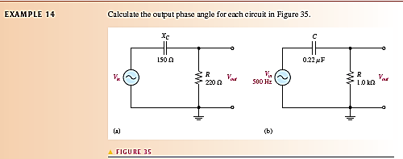
The RC- Lead Circuit

Slide 58
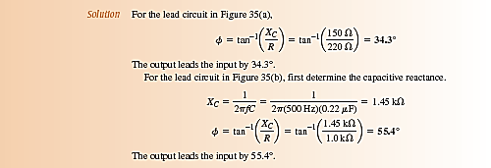
The RC- Lead Circuit

Slide 59
Part (3)

Slide 60
THE BASIC INDUCTOR
An inductor is a passive electrical component formed by a coil of wire and which exhibits the property of inductance.
When a length of wire is formed into a coil, as shown in Figure 1, it becomes an inductor.

Slide 61
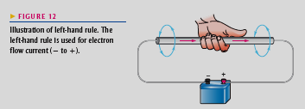
THE BASIC INDUCTOR
Current through the coil produces an electro-magnetic field, as illustrated.
.
Left-Hand Rule

Slide 62
THE BASIC INDUCTOR
Current through the coil produces an electro-magnetic field, as illustrated.
The magnetic lines of force around loop in the winding of the coil effectively add to the lines of force around the adjoining loops, forming a strong electromagnetic field within and around the coil.
.

Slide 63
THE BASIC INDUCTOR
The net direction of the total electromagnetic field creates a north and a south pole.

Slide 64
THE BASIC INDUCTOR Inductance:
Thus, there is current through an inductor, an electromagnetic field is established.
When the current changes, the electromagnetic field also changes.
An increase in current expands the electromagnetic field, and a decrease in current reduces it.

Slide 65
THE BASIC INDUCTOR Inductance:
Therefore, a changing current produces a changing electromagnetic field around the inductor.
In turn, the changing electromagnetic field causes an induced voltage across the coil in a direction to oppose the change in current.
This property is called self-inductance but is usually referred to as simply inductance, symbolized by (L).

Slide 66
THE BASIC INDUCTOR Inductance
Inductance is a measure of a coil’s ability to establish an induced voltage as a result of a change in its current, and that induced voltage is in a direction to oppose change in current.

Slide 67
THE BASIC INDUCTOR
The Unit of Inductance: The henry (H).
The inductance of a coil is one henry when current through the coil, changing at the rate of one ampere per second, induces one volt across the coil.

Slide 68
THE BASIC INDUCTOR
EXAMPLE 1: Determine the induced voltage across a 1 henry inductor when the current is changing at a rate of 2 A/s.
Solution:
vind = L di / dt
= (1 H)(2 A/s) = 2 V
Physical Characteristics of an Inductor See Ref.

Slide 69
Winding Resistance
When a coil is made of a certain material, for example, insulated copper wire, that wire has a certain resistance per unit of length.
When many turns of wire are used to construct a coil, the total resistance may be significant. This resistance is called the dc resistance or the winding resistance (RW).

Slide 70
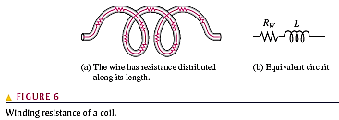
Winding Resistance
Although this resistance is distributed along the length of the wire, it effectively appears
in series with the inductance of the coil, as shown in Figure 6.

Slide 71
TYPES OF INDUCTORS
Inductors are made in a variety of shapes and sizes. Basically, they fall into two general categories: fixed and variable. The standard schematic symbols are shown in Figure 10.
Both fixed and variable inductors can be classified according to the type of core material.

Slide 72
TYPES OF INDUCTORS
Three common types are the air core, the iron core, and the ferrite core. Each has a
unique symbol, as shown in Figure 11.

Slide 73
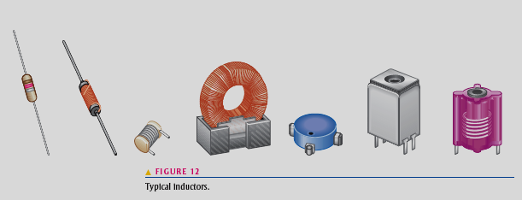
TYPES OF INDUCTORS
A wide variety of inductors exist, and
some are shown in Figure 12.
Small fixed inductors are frequently encapsulated in an insulating material that protects the fine wire in the coil.

Slide 74
SERIES AND PARALLEL INDUCTORS
Total Series Inductance: The formula for LT is expressed in the following equation
for n inductors in series: EXAMPLE 4

Slide 75
SERIES AND PARALLEL INDUCTORS
Total parallel Inductance: The formula for LT is expressed in the following equation
for the general case of n inductors in parallel. EXAMPLE 5

Slide 76
INDUCTORS IN AC CIRCUITS
An inductor passes AC with an amount of opposition called inductive reactance (XL) that depends on the frequency of the AC.
The expression for induced voltage in an inductor was stated

Slide 77
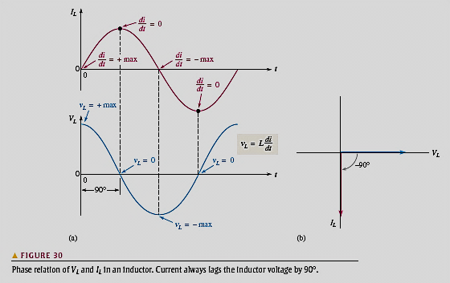
Phase Relationship of Current and Voltage in an Inductor

Slide 78
Inductive Reactance, XL
Inductive reactance is the opposition to sinusoidal current, expressed in ohms. The symbol for inductive reactance , XL
XL is proportional to f.

Slide 79
Inductive Reactance, XL
Inductive reactance is the opposition to sinusoidal current, expressed in ohms. The symbol for inductive reactance , XL
XL is proportional to f L

Slide 80
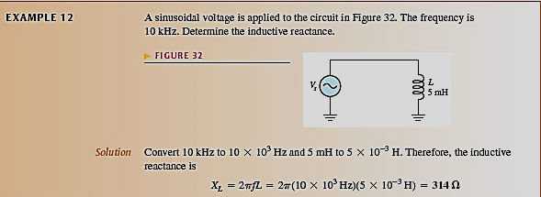
Inductive Reactance, XL

Slide 81
Reactance for Series Inductors, XL
The total inductance of series inductors is the sum of the individual inductances. Because reactance is directly proportional to the inductance, hence:

Slide 82
Reactance for parallel Inductors, XL
The total inductive reactance is the reciprocal of the sum of the reciprocals of the individual reactance's.

Slide 83
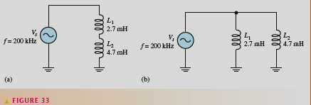
Reactance for Parallel Inductors, XL
Example: What is the total inductive reactance of each circuit of Figure 33?

Slide 84
Reactance for Parallel Inductors, XL
Solution

Slide 85
Reactance for Parallel Inductors, XL
Solution

Slide 86
Ohm’s Law

Slide 87
The Quality Factor (Q) of a Coil
It is the ratio of the reactive power in an inductor to the true power in the winding resistance of the coil . It is a ratio of the power in L to the power in RW.
The quality factor is important in resonant circuits. A formula for Q is developed as follows:

Slide 88
The Quality Factor (Q) of a Coil
The current is the same in L and RW; thus, the I² terms cancel, leaving

Slide 89
Inductor Applications Tuned Circuits
Inductors are used in conjunction with capacitors to provide frequency selection in communications systems.
These tuned circuits allow a narrow band of frequencies to be selected while all other frequencies are rejected.
The tuners in your TV and radio receivers are based on this principle and permit you to select one channel or station out of the many that are available.

Slide 90
Part (4)

Slide 91
SINUSOIDAL RESPONSE OF SERIES RL CIRCUITS
The impedance of a series R-L circuit is determined by the resistance and the inductive reactance.
Inductive reactance is expressed as a phasor quantity in rectangular form as

Slide 92
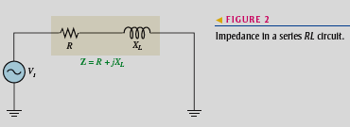
SINUSOIDAL RESPONSE OF SERIES R-L CIRCUITS
In the series R-L circuit of Figure 2, the total impedance is the phasor sum of
R & jXL and is expressed as

Slide 93
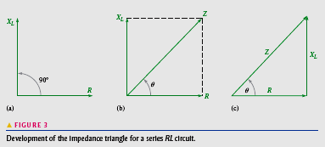
SINUSOIDAL RESPONSE OF SERIES RL CIRCUITS
Since Z is the phasor sum of R and XL its phasor representation is as shown in Figure 3(b).
A repositioning of the phasors, as shown in part (c), forms a right triangle called the impedance triangle.

Slide 94
SINUSOIDAL RESPONSE OF SERIES R-L CIRCUITS
The length of each phasor represents the magnitude of the quantity, and ϴ is the phase angle between the applied voltage and the current ( VS & I) in RL the circuit.

Slide 95
SINUSOIDAL RESPONSE OF SERIES R-L CIRCUITS
The impedance magnitude of the series R-L circuit can be expressed in terms of the resistance and reactance as
The phase angle, ϴ is expressed as

Slide 96
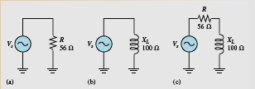
SINUSOIDAL RESPONSE OF SERIES RL CIRCUITS
EXAMPLE : For each circuit in the following Figure write the phasor expression for the impedance in both rectangular and polar forms.

Slide 97
SINUSOIDAL RESPONSE OF SERIES R-L CIRCUITS
Solution:

Slide 98
SINUSOIDAL RESPONSE OF SERIES RL CIRCUITS
Solution:

Slide 99
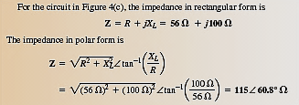
SINUSOIDAL RESPONSE OF SERIES RL CIRCUITS
Solution:

Slide 100
ANALYSIS OF SERIES R-L CIRCUITS
Ohm’s Law:

Slide 101
ANALYSIS OF SERIES R-L CIRCUITS
Ohm’s Law:

Slide 102
Phase Relationships of Current and Voltages
In a series R-L circuit, the current is the same through both the resistor and the inductor.
Thus, the resistor voltage (VR) is in phase with the current, (I) and the inductor voltage (VL) leads the current (I) by 90°.

Slide 103
Phase Relationships of Current and Voltages
Therefore, there is a phase difference of 90° between the resistor voltage, VR, and the inductor voltage, VL, as shown in the waveform diagram of Figure 7.

Slide 104
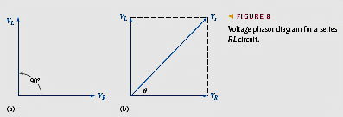
Phase Relationships of Current and Voltages
Since the resistor voltage and the current are in phase, ϴ is also the phase angle between the source voltage and the current.

Slide 105
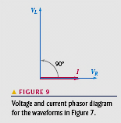
Phase Relationships of Current and Voltages
Figure 9 shows a voltage and current phasor diagram that represents the waveform diagram of Figure 7.

Slide 106
Phase Relationships of Current and Voltages
Example: For the series R-L circuit in Figure 11, determine the magnitude of the total impedance and the phase angle for each of the frequency 10 kHz

Slide 107
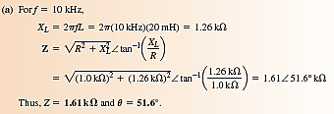
Phase Relationships of Current and Voltages
Solution:

Slide 108
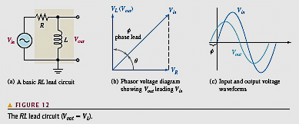
The R-L Lead Circuit
An R-L lead circuit is a phase shift circuit in which the output voltage leads the input voltage by a specified amount.

Slide 109
The R-L Lead Circuit
ϴ is the angle between the current and the input voltage (Vin &I).
It is also the angle between the resistor voltage and the input voltage (VR & Vin ) .

Slide 110
The R-L Lead Circuit
Since VL leads VR by 90°, the phase angle between the inductor voltage and the input
voltage is the difference between 90° & ϴ as shown in Figure 12(b).

Slide 111
The R-L Lead Circuit
The inductor voltage is the output; it leads the input by angle φ , thus creating a basic lead circuit.

Slide 112
The R-L Lead Circuit
φ = 90⁰ - ϴ

Slide 113
The R-L Lead Circuit
Example: Determine the amount of phase lead from input to output in circuit in Figure 14.

Slide 114
The R-L Lead Circuit
Solution :

Slide 115
POWER IN R-L CIRCUITS
When the resistance in a series R-L circuit is greater than the inductive reactance, more of the total energy delivered by the source is converted to heat by the resistance than is stored by the inductor.

Slide 116
POWER IN R-L CIRCUITS
Likewise, when the reactance is greater than the resistance, more of the total energy is stored and returned than is converted to heat.

Slide 117
POWER IN R-L CIRCUITS
The power dissipation in a resistance is called the true power.
The power in an inductor is reactive power and is expressed as

Slide 118
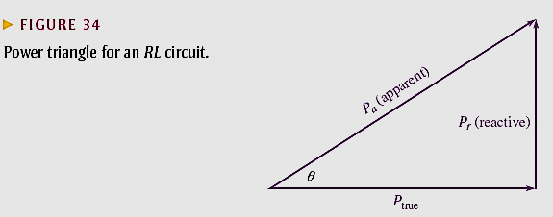
The Power Triangle for R-L Circuits
The generalized power triangle for a series RL circuit is shown in Figure 34.
The apparent power, Pa, is the resultant of the average power, Ptrue, and the reactive power, Pr.

Slide 119
The Power Triangle for RL Circuits
The power factor equals the cosine of ϴ

Slide 120
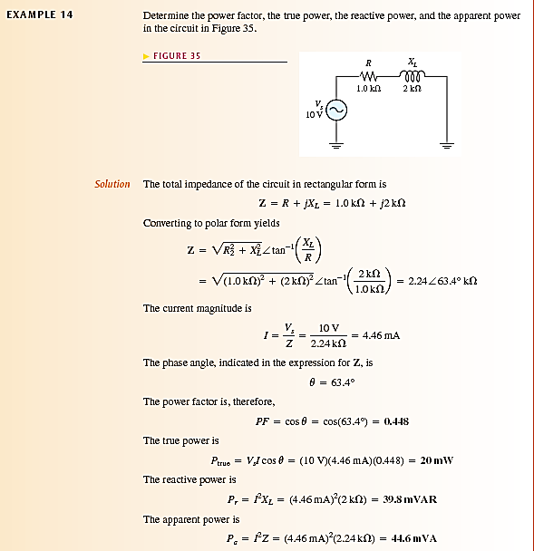
The Power Triangle for R-L Circuits

Slide 121
The Power Triangle for RL Circuits

Slide 122
Basic Applications R-L Circuit as a Filter
Low-Pass Filter: In figure 38 (a), the input is zero frequency (dc). The output voltage equals the full value of the input voltage (neglecting the winding resistance). Therefore, the circuit passes all of the input voltage to the output (10 V in, 10 V out).

Slide 123
R-L Circuit as a Low-Pass Filter
In Figure 38(b), the frequency of the input voltage has been increased to 1 kHz, the output voltage is approximately 8.47 V rms, which can be calculated using the voltage divider approach or Ohm’s law.

Slide 124
R-L Circuit as a Low-Pass Filter
In Figure 38(c), the input frequency has been increased to 10 kHz, causing the inductive reactance to increase further to 628.3 .For a constant input voltage of 10 V rms, the output voltage is now 1.57 V rms.

Slide 125
R-L Circuit as a Low-Pass Filter
As the input frequency is increased further, the output voltage continues to decrease and approaches zero as the frequency becomes very high, as shown in Figure 38(d) for f = 20 kHz.

Slide 126
R-L Circuit as a Low-Pass Filter
It is apparent that the lower frequencies pass through the circuit much better than the higher frequencies. This R-L circuit is a basic form of low-pass filter.
Figure 39 shows a response curve for a low-pass filter.

Slide 127
Part (5)

Slide 128
RLC CIRCUITS AND RESONANCE
SERIES CIRCUITS
Impedance of Series RLC Circuits
Inductive reactance (XL) causes the current to lag the applied voltage.
Capacitive reactance (XC) causes the current to lead the voltage.

Slide 129
RLC CIRCUITS AND RESONANCE
SERIES CIRCUITS
Impedance of Series RLC Circuits
Thus XL and XC tend to offset each other. When they are equal, they cancel, and the total reactance is zero.

Slide 130
RLC CIRCUITS AND RESONANCE
SERIES CIRCUITS
Impedance of Series RLC Circuits
In any case, the magnitude of the total reactance in the series circuit is

Slide 131
RLC CIRCUITS AND RESONANCE
SERIES CIRCUITS
Impedance of Series RLC Circuits

Slide 132
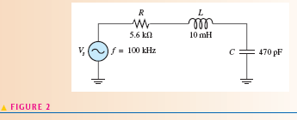
RLC CIRCUITS SERIES CIRCUITS
Example: For the series RLC circuit in Figure 2, determine the total impedance. Express it in both rectangular and polar forms.

Slide 133
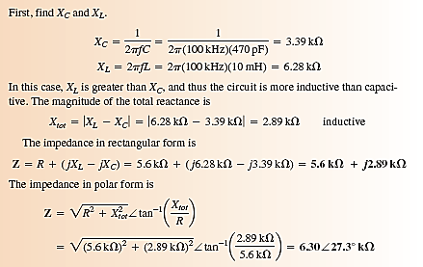
RLC CIRCUITS SERIES CIRCUITS
Solution:.

Slide 134
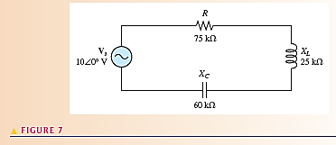
ANALYSIS OF SERIES RLC CIRCUITS
Determine current in series RLC – circuits
Example: Find the current in series RLC – circuit in figure 7.

Slide 135
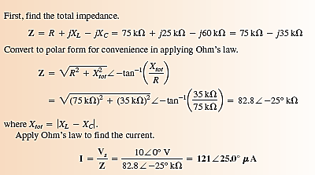
ANALYSIS OF SERIES RLC CIRCUITS
Determine current in series RLC – circuits
Solution:

Slide 136
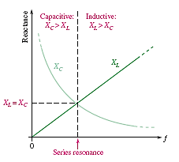
Series Resonance
In a series RLC circuit, series resonance occurs when XC=XL. The frequency at which resonance occurs called the resonant frequency and is designated fr.

Slide 137
Series Resonance
Figure 9 illustrates the series resonant condition.
In a series RLC circuit, the total impedance was given as: Z = R + jXL - jXC

Slide 138
Series Resonance
At resonance, XL=XC and the j terms cancel; thus, the impedance is purely resistive.
These resonant conditions are stated in the following equations:
XL = XC
Zr = R

Slide 139
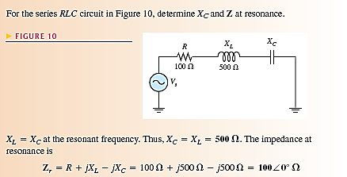
Series Resonance
Example:

Slide 140
Series Resonant Frequency
For a given series RLC circuit, resonance occurs at only one specific frequency.
A formula for this resonant frequency is developed as follows:

Slide 141
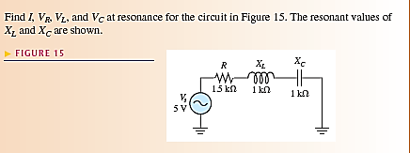
Current and Voltages in a Series RLC Circuit
Example:

Slide 142
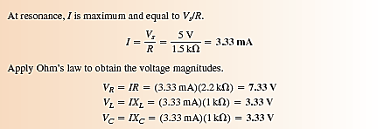
Current and Voltages in a Series RLC Circuit
Solution:

Slide 143
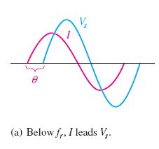
The Phase Angle of a Series RLC Circuit
At frequencies below resonance XC > XL, the current leads the source voltage

Slide 144
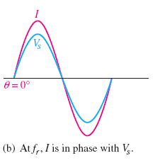
The Phase Angle of a Series RLC Circuit
The phase angle decreases as the frequency approaches the resonant value and is 0° at resonance, as indicated in part (b).

Slide 145
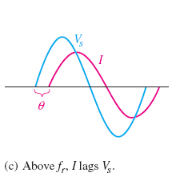
The Phase Angle of a Series RLC Circuit
At frequencies above resonance, XL > XC and the current lags the source voltage, as indicated in part (c)

Slide 146
The Phase Angle of a Series RLC Circuit
As the frequency goes higher, the phase angle approaches 90°

